Slide 1
Sedimentary Rock Formation

Slide 2
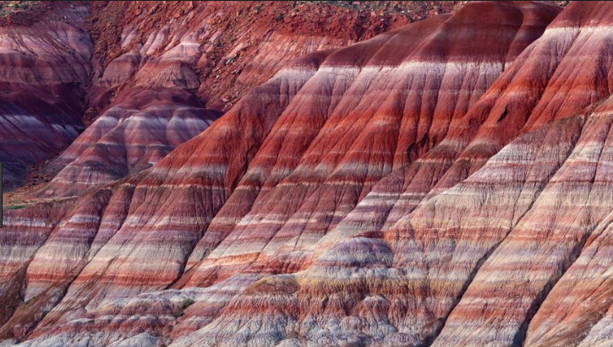
How are sedimentary rocks formed?
Sedimentary rocks are formed when existing rocks are weathered (broken), eroded (moved), deposited (dropped), and lithified (harden) to form new rocks.

Slide 3
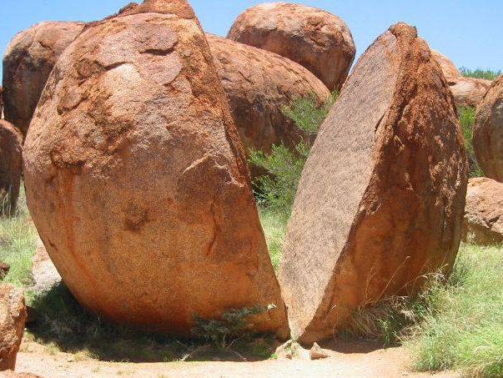
Weathering
Weathering - processes at or near Earth’s surface that cause rocks and minerals to break

Slide 4
Weathering
Mechanical Weathering - processes that break a rock into smaller pieces without altering its composition
Chemical Weathering - processes that change the chemical composition of rocks and minerals transforming them into new rocks.

Slide 5
Agents of Mechanical Weathering
These are actions/ occurrences that break down Earth materials (Rocks!):
frost wedging
thermal expansion and contraction
mechanical exfoliation
abrasion by wind, water or gravity
plant (growth) wedging

Slide 6
Agents of Mechanical Weathering
Frost Wedging – splintering of rock caused by the expansion of water as it freezes in crevices and cracks.
http://www.uwsp.edu/geo/faculty/ozsvath/images/frost%20wedging.jpg

Slide 7
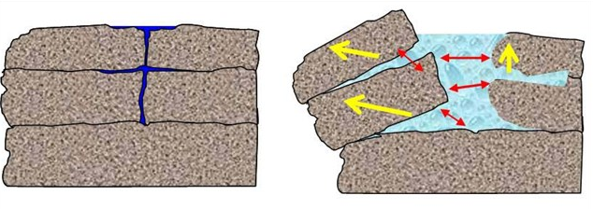
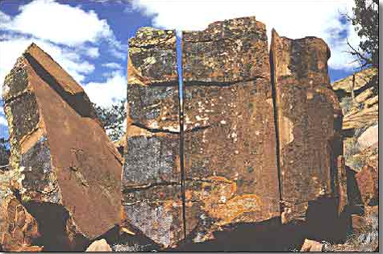
Frost Wedging
Water trickles into cracks and crevices in the rock.
As the water freezes, it expands forcing the rock to split apart.

Slide 8
Agents of Mechanical Weathering
Thermal expansion and contraction –
repeated heating and cooling of materials cause rigid substances to crack and separate as they expand and contract.
http://content.answers.com/main/content/wp/en-commons/thumb/d/dc/250px-Weathering_freeze_thaw_action_iceland.jpg

Slide 9
Agents of Mechanical Weathering
Exfoliation – Underlying rock layers expand causing the outer layers to split due to pressure.
This causes the rigid upper layers to crack and sections to slide off (similar to peeling of outer skin layers after a sunburn). The expanding layers often form a dome.

Slide 10
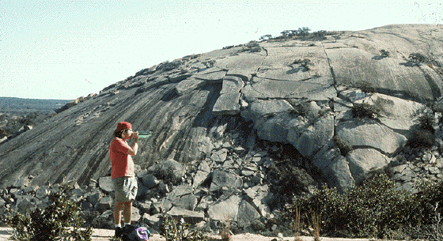
Dome Exfoliation

Slide 11
Processes and Agents of Mechanical Weathering
Abrasion – travelling sediments (rock sections) can break off pieces from a rocky surface they repeatedly strike against it. The constant rubbing against the rock causes it to slowly break away.
The sediments can be moved by wind, water, or gravity.

Slide 12
Wind Abrasion
http://www.uwsp.edu/geo/faculty/ritter/geog101/textbook/images/lithosphere/eolian/rock_wind_abrasion_p0772932441_NRCS.jpg

Slide 13
Wind and Water Abrasion
http://www.gsi.ie/Education/European+Landscapes/United+Kingdom.htm Photo Ref: P211442, "IPR/52-34CW BGS©NERC

Slide 14
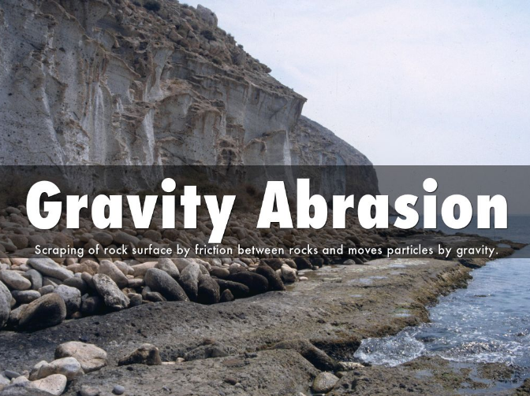
As items from above fall to the ground, they bump into and scrape against existing rock, gradually weathering the rock’s surface.

Slide 15
Agents of Mechanical Weathering
Plant Growth Wedging– As plants send out root systems, the roots find their way into cracks in the rocks. As the roots increase in size, they force the rock sections apart, increasing the separation and weathering the rock as they grow.

Slide 16
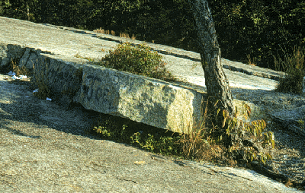
Plant Wedging

Slide 17
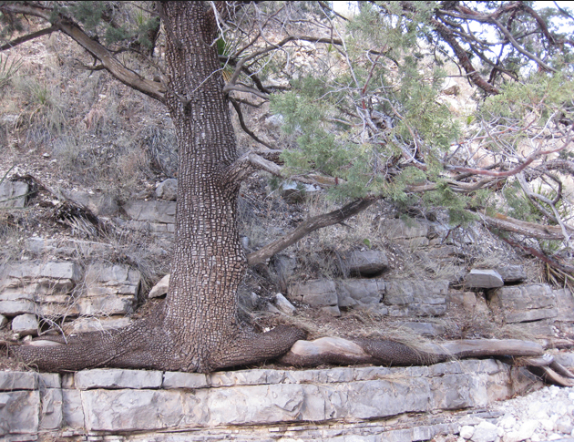
Plant Wedging

Slide 18
Agents of Chemical Weathering
dissolution (dissolving)
oxidation
hydrolysis

Slide 19
Agents of Chemical Weathering
Dissolution (the act of dissolving)
Water, especially water containing carbonic acid, will dissolve minerals from a rock leaving cavities in the rock.
These cavities may generate sinkholes and potholes in roads. Dissolution is also responsible for cave features such as stalactites and stalagmites.

Slide 20
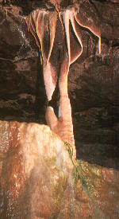
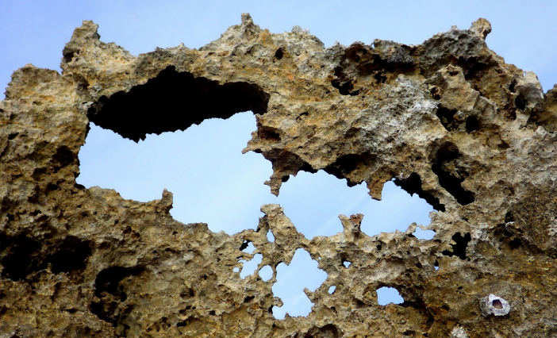
Limestone cave feature as a result of dissolution
Dissolution due to carbonic acid.

Slide 21
Agents of Chemical Weathering
Oxidation
Minerals may combine with oxygen to form new minerals that are not as hard. For example, the iron-containing mineral pyrite forms a rusty-colored mineral called limonite.

Slide 22
Pyrite Oxidation
http://www.windows.ucar.edu/earth/geology/images/pyrite_sm.jpg
Pyrite
http://www.dkimages.com/discover/previews/965/75014124.JPG
Limonite

Slide 23
Processes of Chemical Weathering
Hydrolysis
Minerals may chemically combine with water to form new minerals. Again, these are generally not as hard as the original material.

Slide 24
Feldspar Hydrolysis
http://www.mii.org/Minerals/Minpics1/Plagioclase%20feldspar.jpg
http://www.uwm.edu/Course/422-100/Mineral_Rocks/kaolinite1.jpg
Feldspar
Kaolinite
Hydrolysis causes feldspar to transform into kaolinite, a type of clay that is very easy to break apart.

Slide 25
Factors in Chemical Weathering
Climate – wet and warm climates maximize chemical reactions
Plants and animals – living organisms secrete substances that react with rock helping to speed chemical weathering
Time – longer exposure means greater change
Mineral composition – some minerals are more susceptible to change than others

Slide 26
What is the end result of weathering?
Weathering produces sediment, tiny fragments of broken rock that can easily be transported by natural means.
The term regolith (“rock blanket”) refers to the small rock and mineral fragments that cover much of earth’s surfaces. We often call this dirt. When organic matter is mixed into regolith, it is called soil.

Slide 27
Step 2: Erosion
Erosion – the process of removing sediment from its original site after weathering and transporting it to a new location.

Slide 28
Erosion Transport Agents or Forces
Water
rain
streams and rivers
ocean dynamics
ice in glaciers
Wind
Gravity

Slide 29
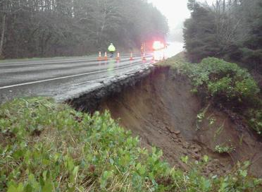
Erosion Transport Agent: Water
Often, when it rains, surface runoff will carry sediment with it moving it as the water flows.

Slide 30
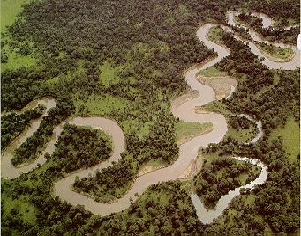
Moving Water
Flowing water (such as in a river, ocean, or other body of water) will lift and carry small
sediments such as silt and sand.

Slide 31
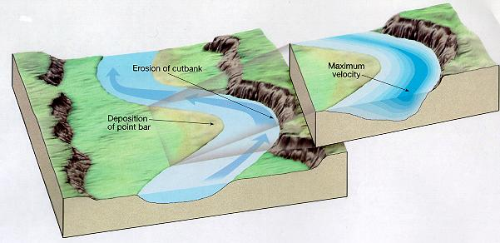
Stream Erosion and Deposition
Where water moves more swiftly there will be more
erosion.
Where the water slows down, sediments will be
deposited.

Slide 32
Ocean Dynamics
Tidal action and waves carry away weathered materials.
http://edge.tamu.edu/waves2001/PC_tour/erosion_files/image002.jpg
http://www.dkimages.com/discover/previews/1000/50195183.JPG

Slide 33
Glaciers
Glaciers are large ice fields that slowly flow downhill over time pushing sediment along with them.
http://images.encarta.msn.com/xrefmedia/sharemed/targets/images/pho/t628/T628797A.jpg

Slide 34
Glaciers
Glacial ice drags rocky material that scours the surface it flows over . The glacier deposits debris as it melts.
http://www.geology.um.maine.edu/user/Leigh_Stearns/teaching/kelley_island.jpg

Slide 35
Wind Transport of Sediments
Wind will carry fine, dry sediments over
long distances.

Slide 36
Wind Transport of Dust
Photo shows Sahara Desert sand being transported over
the Atlantic Ocean.

Slide 37
Transport by Gravity
When sediments are weathered they may be transported downward by gravity. Consider landslides as an example.
http://en.wikipedia.org/wiki/Mass_wasting

Slide 38
Transport by Gravity
When sediments are weathered they may be transported downward by gravity leaving a slump in the land.
Slump
(a dip in a land formation)
http://new.filter.ac.uk/database/image.php?id=594

Slide 39
Transport by Gravity
Loose sediments transported by gravity are called scree.
Scree field
http://www.dave-stephens.com/scrambles/banff/aylmer/aylmer013.jpg

Slide 40
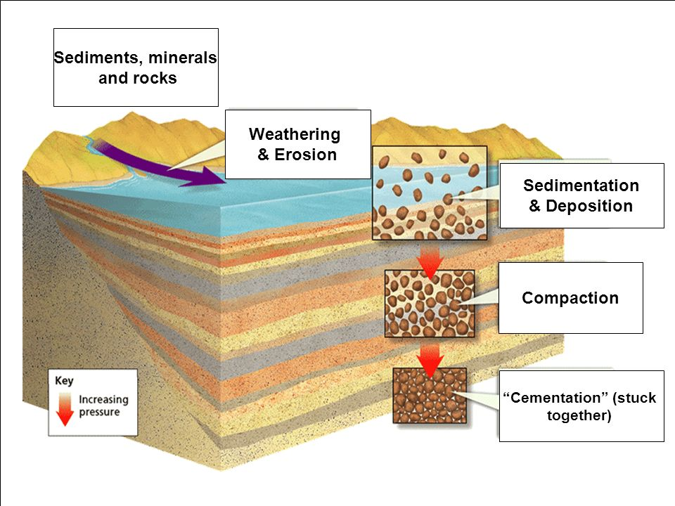
Deposition
Deposition is the dropping/laying down of sediment that has been moved by erosion (water, wind, or gravity). This sediment can be in the form of dirt, silt (sediment less than $1/{20}$ mm), mud, sand, clay, etc.

Slide 41
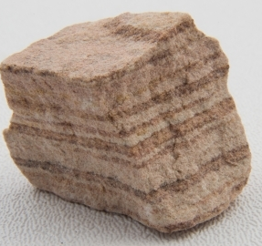
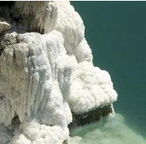
Deposition continued
As more sediment is deposited, it layers on top of previously deposited material. This gradual deposition causes
visible layers in the rock.
Deposits can be made by slowly
moving water (such as on the inner curve of a riverbank), melting ice (all of the sediment in the ice will be left behind), when the wind stops blowing, and even by
evaporation.
Notice the layers in this sandstone
Rock salt often forms when from salty water evaporating, leaving layers of salt behind

Slide 42
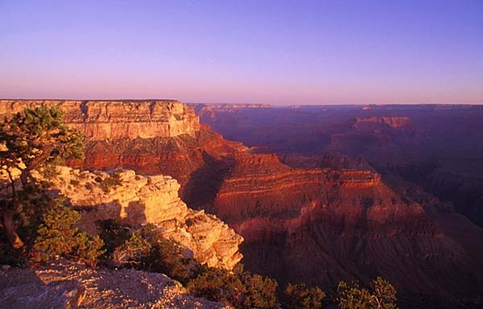
Deposition Formation
Transported sediments are deposited in
layers and generate strata like those found
in the Grand Canyon.

Slide 43
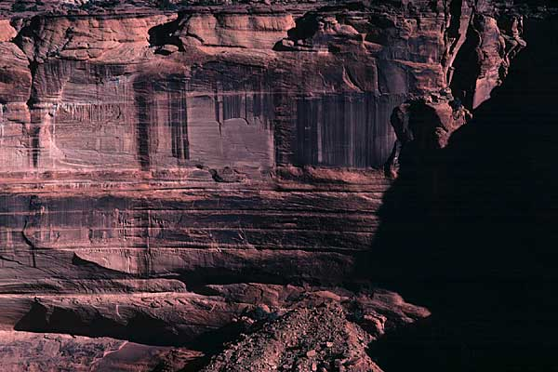
Deposition Formation

Slide 44
Step 4: Lithification
Lithification is the process of making loose sediment rigid and hard.
Lithification requires 2 steps: compacting and cementing.

Slide 45
Compacting
As sediment is deposited, it presses down on the sediment beneath it, forcing the individual pieces to move closer together.

Slide 46
Compacting continued
The pressure of increasing amounts of sediment piling on top causes sediment at the bottom to squish together closing the spaces between them.

Slide 47
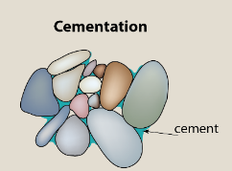
Cementing
Cementing occurs when the loose sediments become stuck together (as if covered in cement).
This can happen because the sediment dries out (water evaporates) or when certain minerals such as silica (SiO₂) and cause sediment to stick together.

Slide 48
Characteristics of Sedimentary Rock
Sedimentary Rocks are:
The softest rock type (easy to crumble)
Grainy in texture
Made of sediments
Layered

Slide 50
Weathering Tutorial
This tutorial requires Flash but is a nice review of mechanical and chemical weathering with some animations.
http://www.as.uky.edu/academics/departments_programs/EarthEnvironmentalSciences/EarthEnvironmentalSciences/Educational%20Materials/Documents/elearning/module07swf.swf

